Slide 1
Identity Conversion of B Cells through Notch2
Thursday Seminar
Markus Lechner
14.02.2019

Slide 2
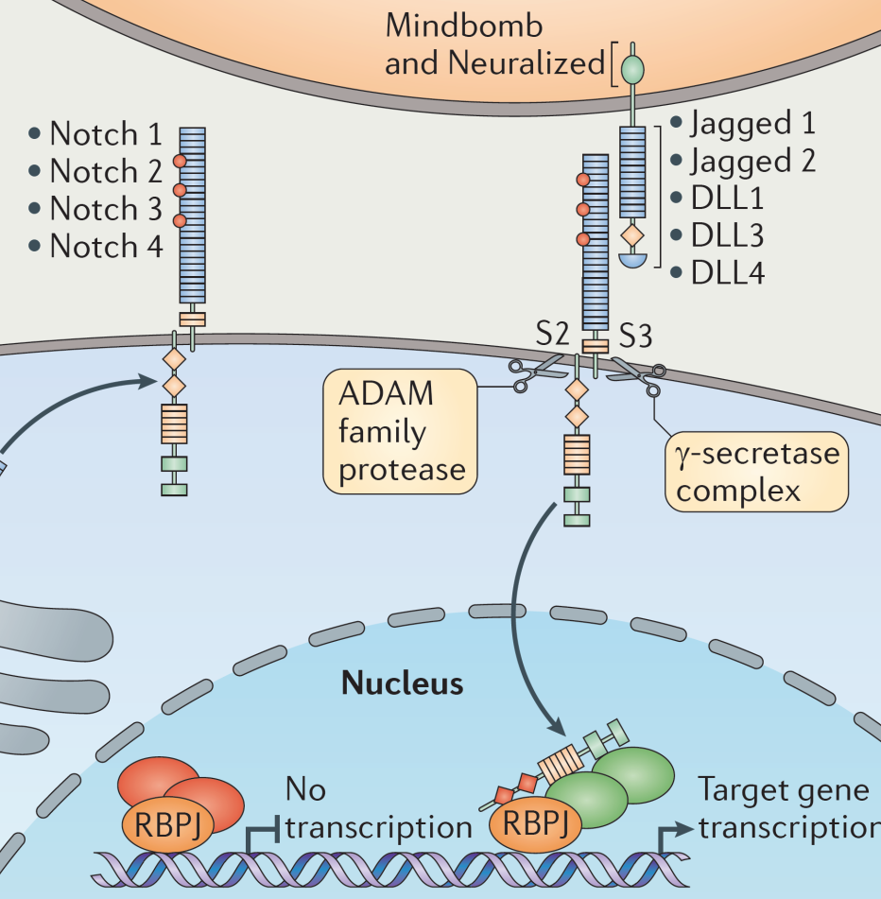
Notch signaling pathway
Ligand binding initiates two proteolytic cleavages
γ-secretase cleavage releases intracellular Notch domain (NotchIC)
NotchIC translocates to the nucleus to induce transcription of target genes
NotchIC
Radtke et al. Nat Immunol 2013
Notes:
Notch signaling is an evolutionary conserved signaling pathway in almost all multicellular organisms and is best known for cell fate decisions during embryogenesis and neurogenesis.

Slide 3
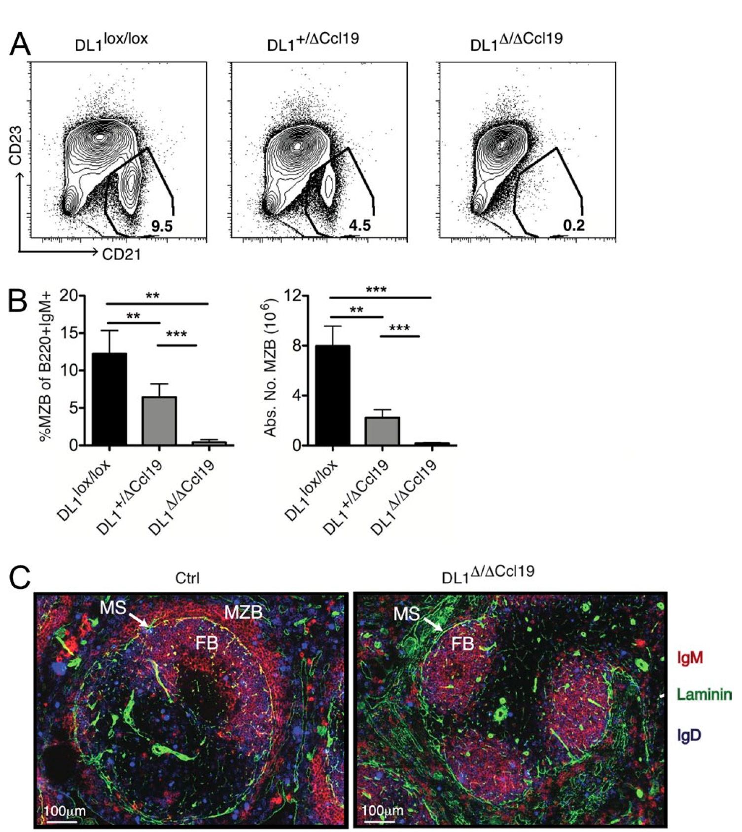
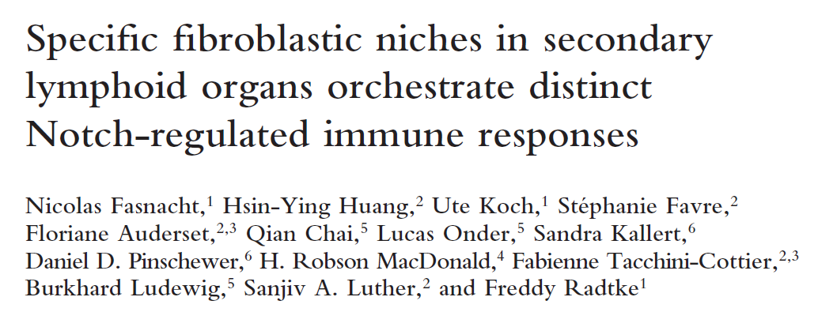
Final MZB differentiation takes place within splenic follicles
MZ B cell development is dependent on Dll1 expression on follicular fibroblasts!
Notes:
Transitional B cells were long time thought to receive Notch2 ligand stimulation in splenic blood vessels and the red pulp upon influx from the bone marrow.
Four years ago an important paper was published from the Radtke lab indicating that MZB differentiation takes place within splenic follicles!
They knocked out Notch2 ligands on various cell types and eventually found that
MZB development is dependent on DLL1 expression on follicular fibroblasts that are strictly located in the splenic white pulp

Slide 4
Generation of MZB cells from FoB cells upon Notch2IC induction
Day -8 to -2:
4x anti-IL7R AB
Notch2IC
Mice were treated 4x with anti-IL7R antibody and 1x with tamoxifen
Day 0:
1x 5mg Tamoxifen

Slide 5
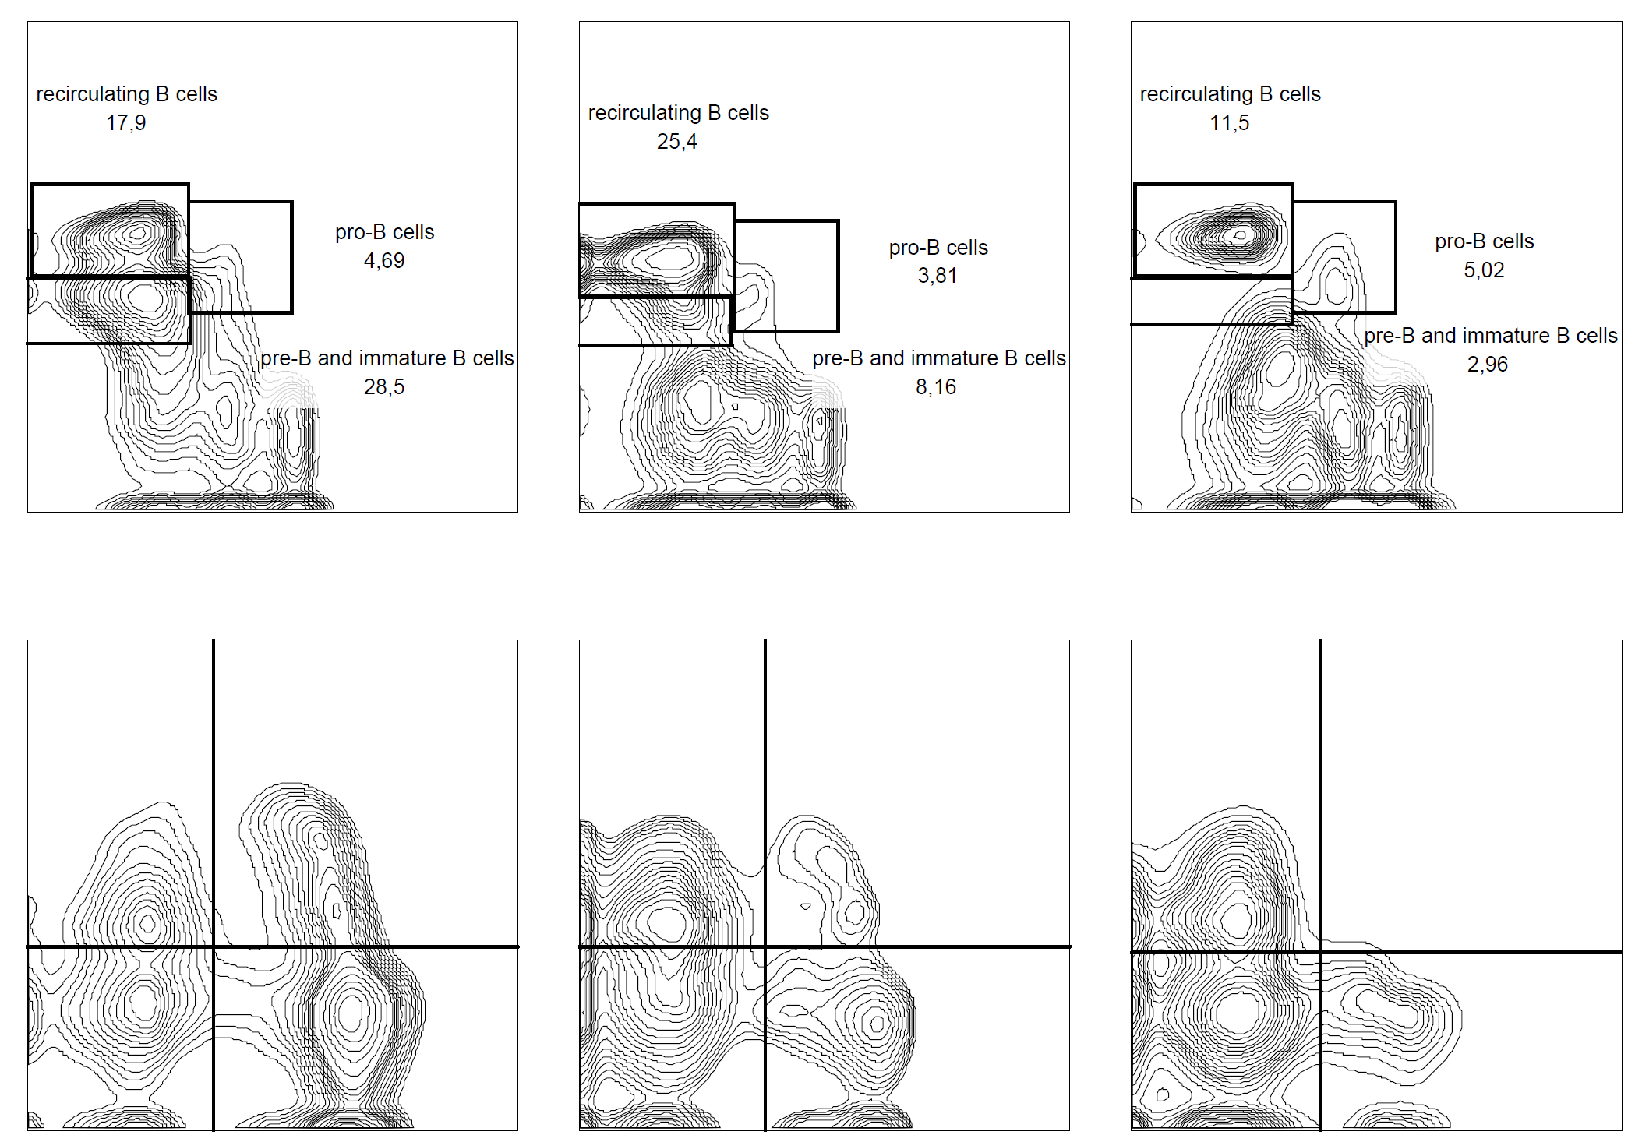
Pre-Treatment with anti-IL7R antibody
w/o
3x αIL7R
4x αIL7R
Pre-treatment with anti-IL7R antibody blocks bone marrow B cell development.
4 injections of anti-IL7R block differentiation to B220⁺,CD43⁻ pre-B cells
/lymphocytes
B220
CD43
/lymphocytes
/B220⁺
No efflux of IgM⁺, AA4.1⁺ immature B cells from the bone marrow
IgM
AA4.1

Slide 6
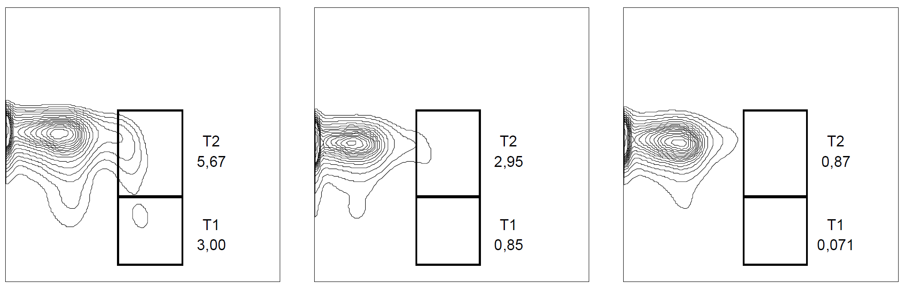
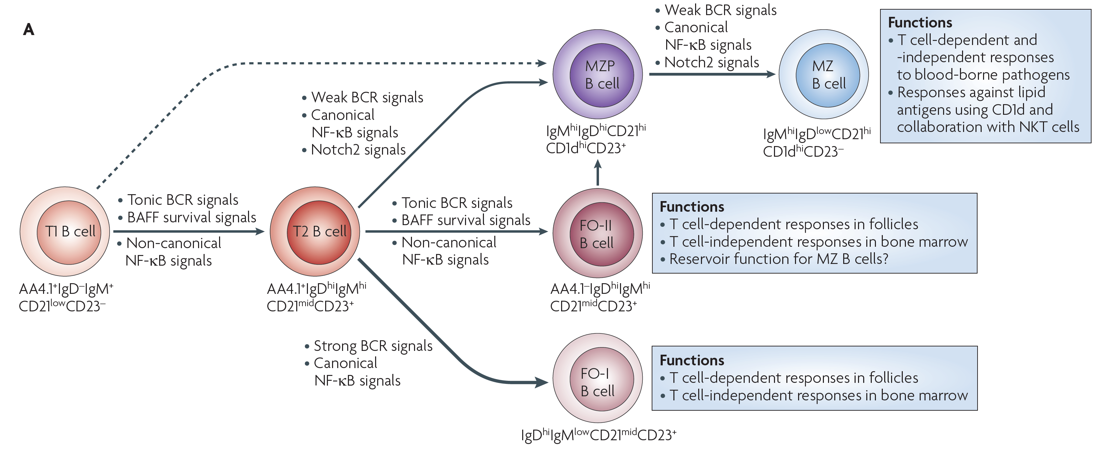
Pre-Treatment with anti-IL7R antibody depletes transitional B cells
Bone marrow immature B cells
Splenic transitional B cells
w/o
α-IL7R
w/o
α-IL7R
9,91
0,51
IgM
CD23
AA4.1
AA4.1
4x anti-IL7R within one week
depletes transitional B cell population in the spleen
Notes:
population in the spleen. Coming back to the differentiation scheme I showed you in the beginning, (KLICK),
I can now ensure that only mature follicular B cells can respond to tamoxifen to really validate the signature conversion of follicular to marginal zone B cells

Slide 7
Mouse model for inducible, constitutively active Notch2 signaling:
Notch2IC^{flSTOP}//CD19cre-ERT2
CAR^{flSTOP}//CD19cre-ERT2
Notch2IC^{flSTOP}
Notch2IC
hCD2
CAR
CAR^{flSTOP}
CAGGS
STOP
Notch2IC
hCD2
Notch2IC
hCD2
CAGGS
STOP
CAR
loxP
loxP
IRES
IRES
loxP
loxP
Cre
+ Tamoxifen
Cre
ERT2
HSP90
CD19creER^{T2}
CD19creER^{T2}
CD19
CreERT2
CD19
CreERT2

Slide 8
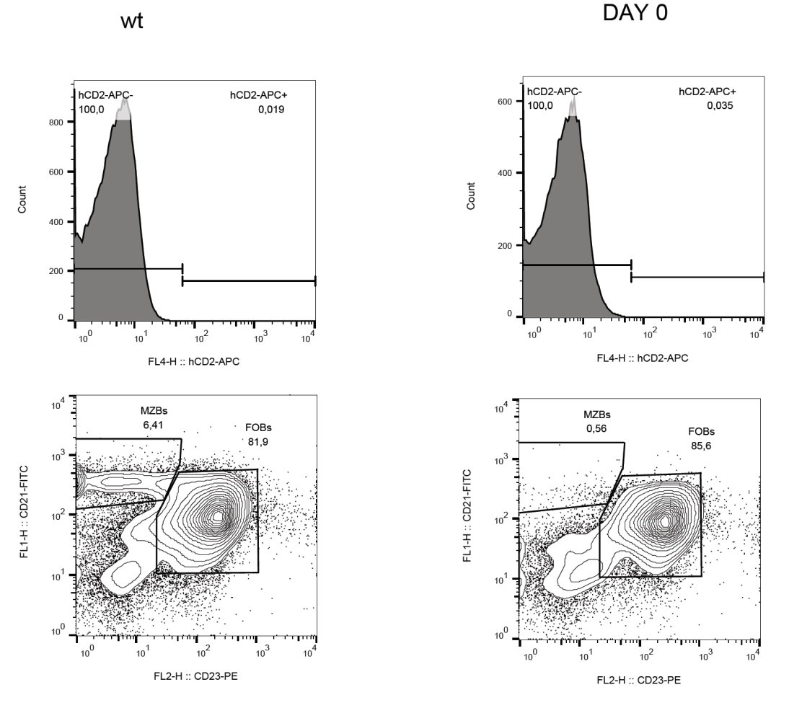
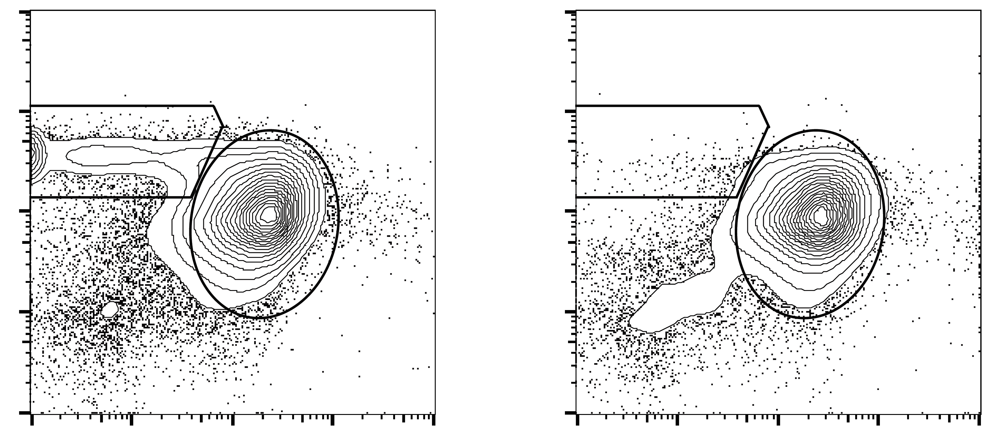
MZB depletion in CD19-knockout mice
wild type
Untreated Notch2IC//CD19-CreERT2^{+/+}
6,5 % MZB
5-10 % MZBs
CD21
80-90% FOBs
CD23
hCD2 Reporter
Untreated mice (day 0, hCD2⁻):
CD19 knockout, no MZBs

Slide 9
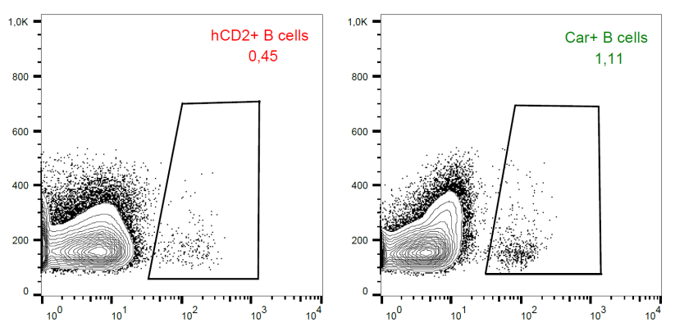
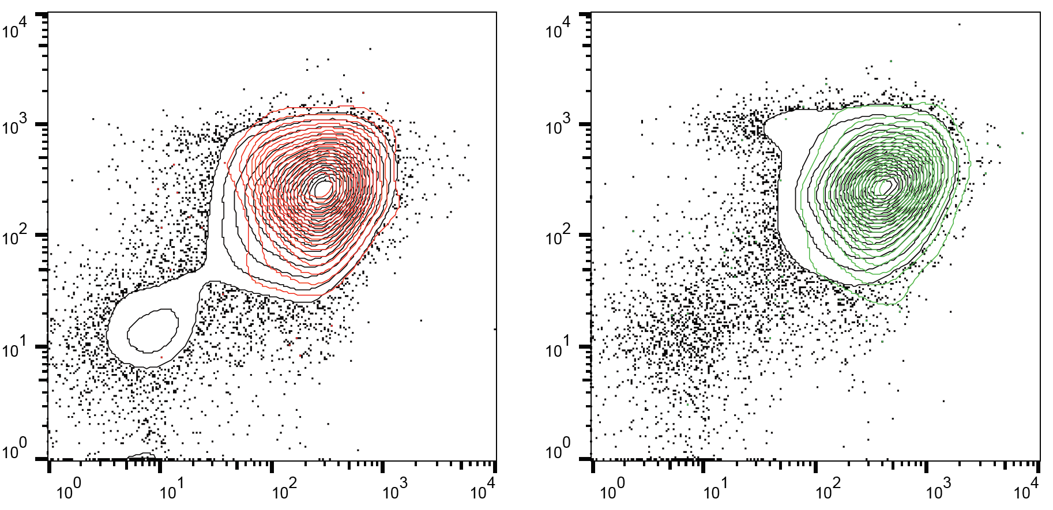
Early response to 1x Tamoxifen treatment: all reporter⁺ cells are FOBs
A single treatment with 1x 5mg enables us to follow up the kinetic of Notch2IC induction and cell phenotype
Transgene expression 48h after single dose TAM
Notch2IC//
CD19-CreERT2^{+/+}
CAR//
CD19-CreERT2^{+/+}
SSC
Reporter
CD21
CD23

Slide 10
Induction of Notch2IC induces identity conversion of FOB to MZB surface phenotype after 1x tamoxifen induction
Day 3
Day 5
Day 7
Day 14
CD21
CD23

Slide 11
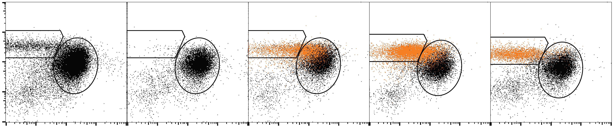
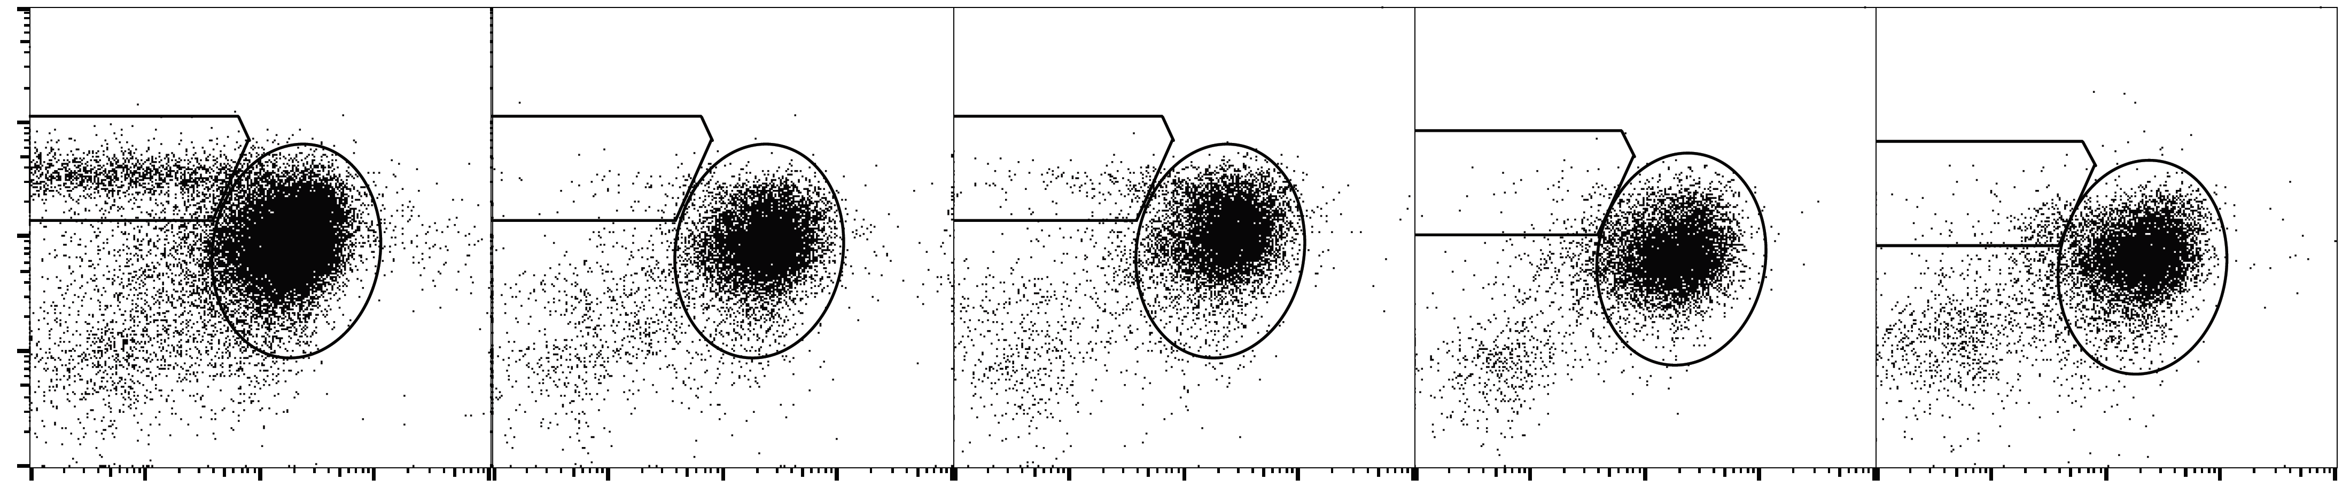
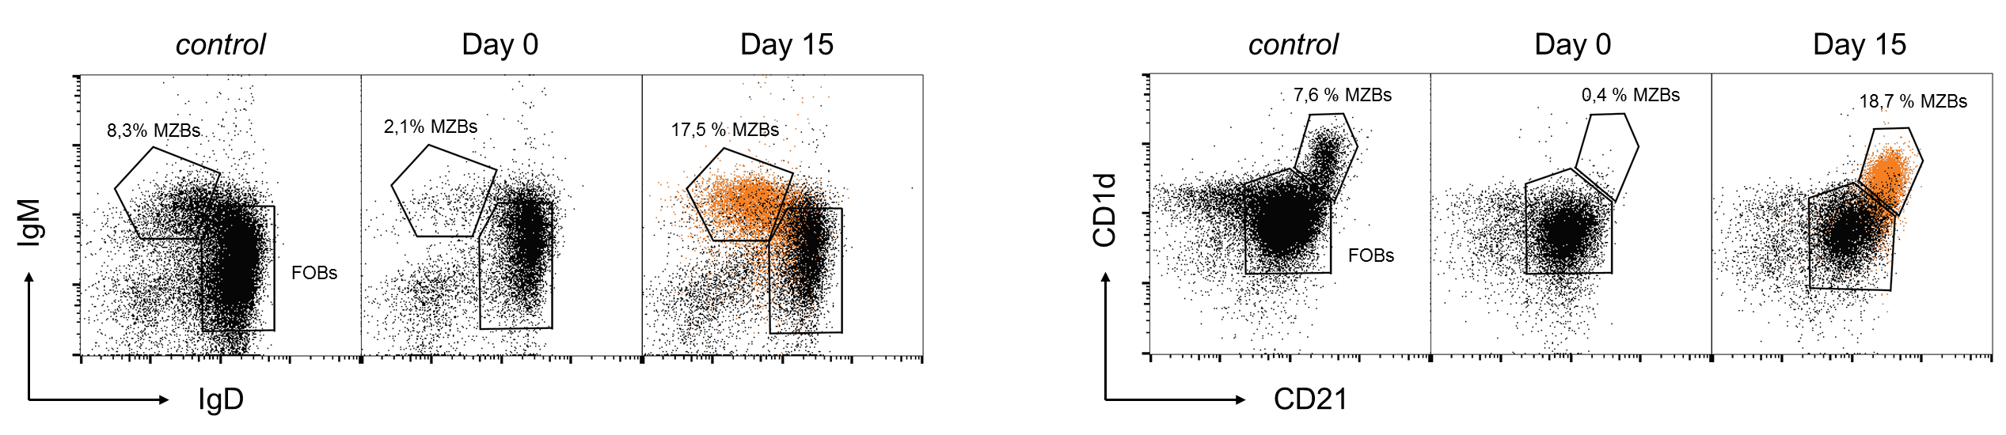
Regeneration of marginal zone B cells after Notch2IC induction
Notch2IC^{+/-}_CD19cre-ERT2^{+/+}
5x 5mg Tamoxifen, analysis 1, 2, 4 weeks after first treatment
control
Day 0
Day 8
Day 15
Day 30
Spleen
/Lymphocytes
/B220⁺,hCD2⁻
6,5 % MZBs
0,5% MZBs
9,4% MZBs
28,3% MZBs
18,9% MZBs
hCD2
CD21
CD23
Regeneration of marginal zone B cells 2-4 weeks after tamoxifen treatment

Slide 12
Kinetics of Notch2IC-expressing B cells and MZB phenotype
Frequency of hCD2⁺ B cells
MZB phenotype within hCD2⁺ B cells
Days after TAM treatment
Days after TAM treatment

Slide 13
Induction of Notch2IC induces identity conversion of FOBs to MZBs in CD19-creERT2^{+/-} mice
Additional effect: Further increase of non-transgenic MZBs after Notch2IC induction
Notes:
CD19 proficient cells

Slide 14
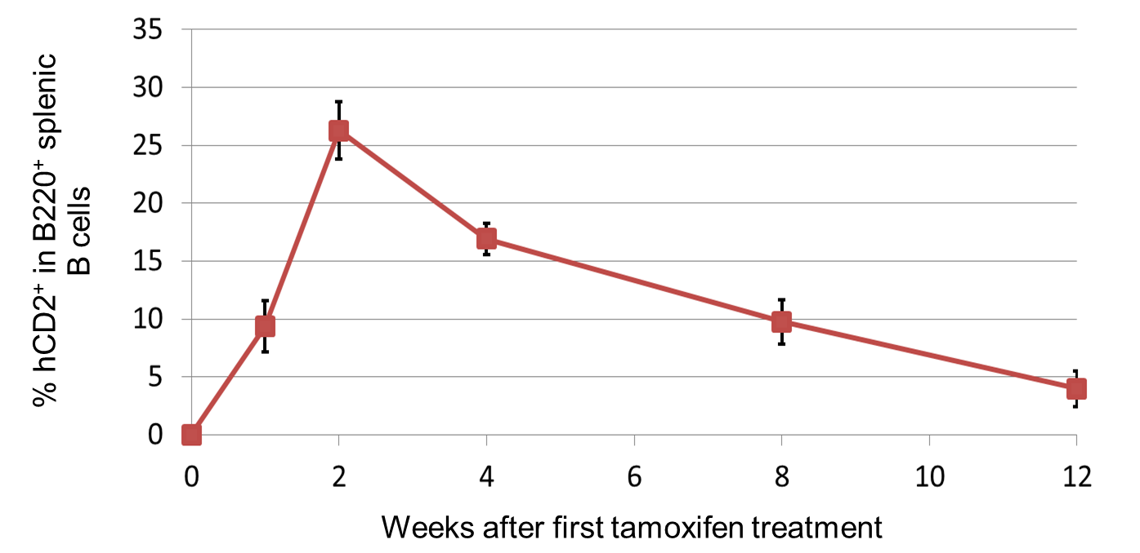
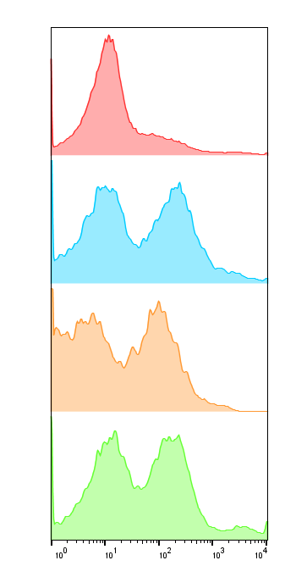
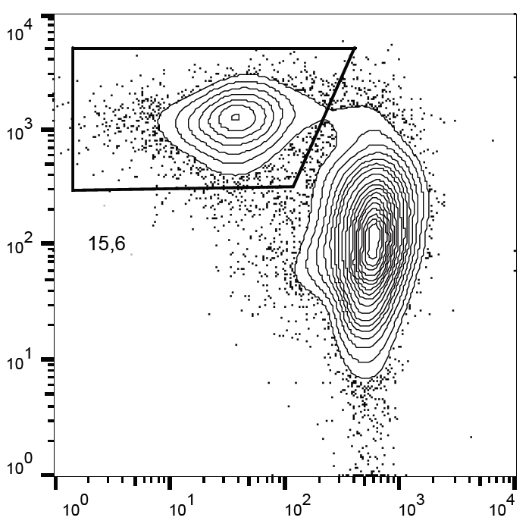
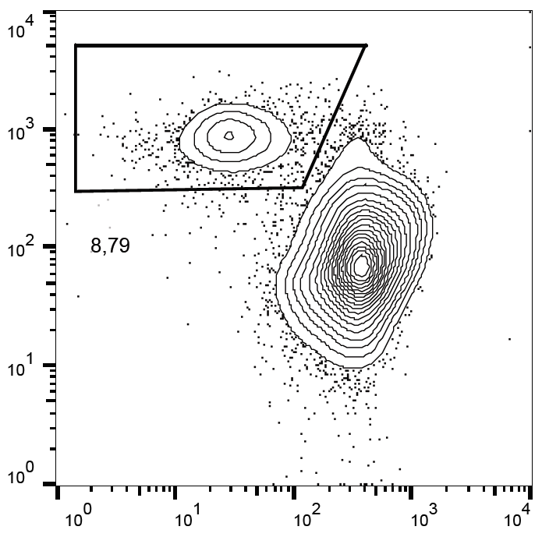
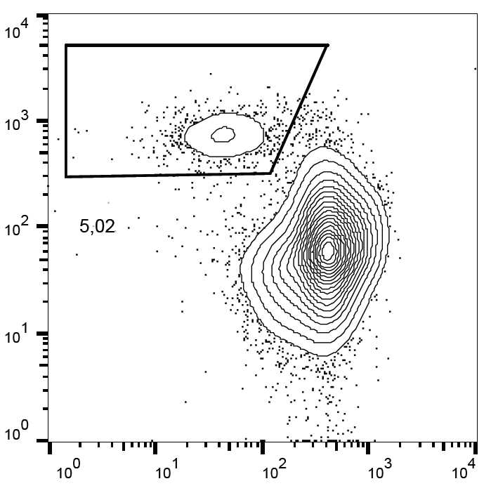
Kinetics of transgenic hCD2⁺ splenic B cells
Day 8
Day 0, B220⁺
13% ^{+/-}2
Day 8, hCD2⁺
Day 15
7% ^{+/-}2
Day 15, hCD2⁺
Day 30, hCD2⁺
Day 30
Reduction of transgenic cells due to differentiation to short-lived plasmablasts?
Ki67
4% ^{+/-}0,5
IRF4
B220

Slide 15
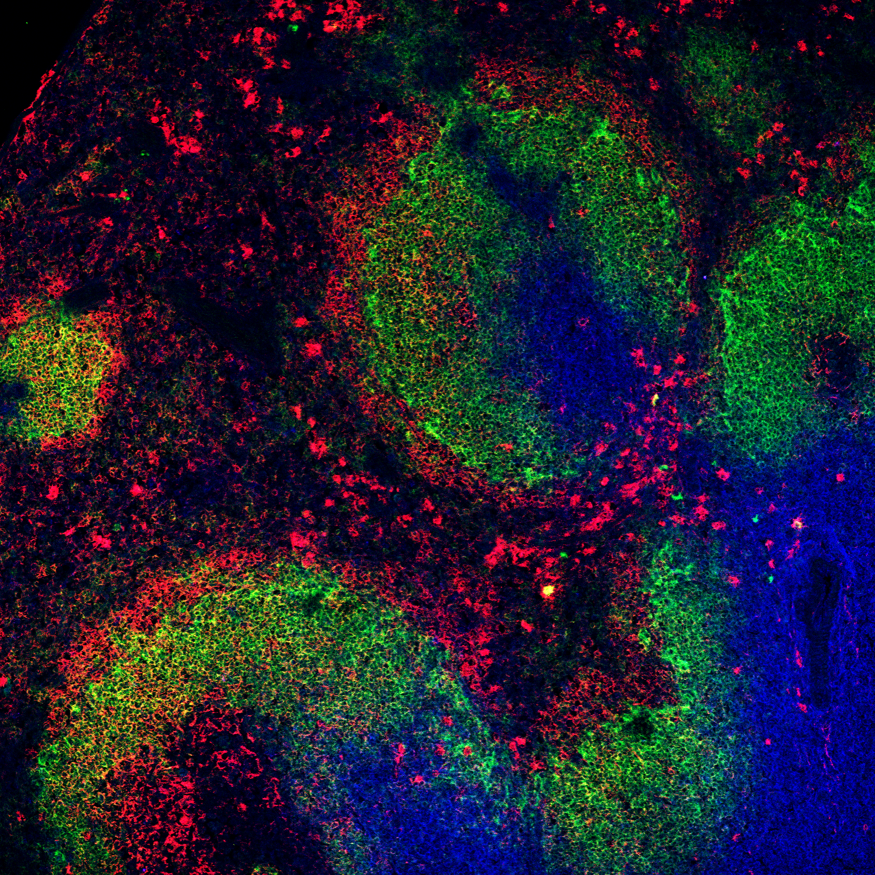
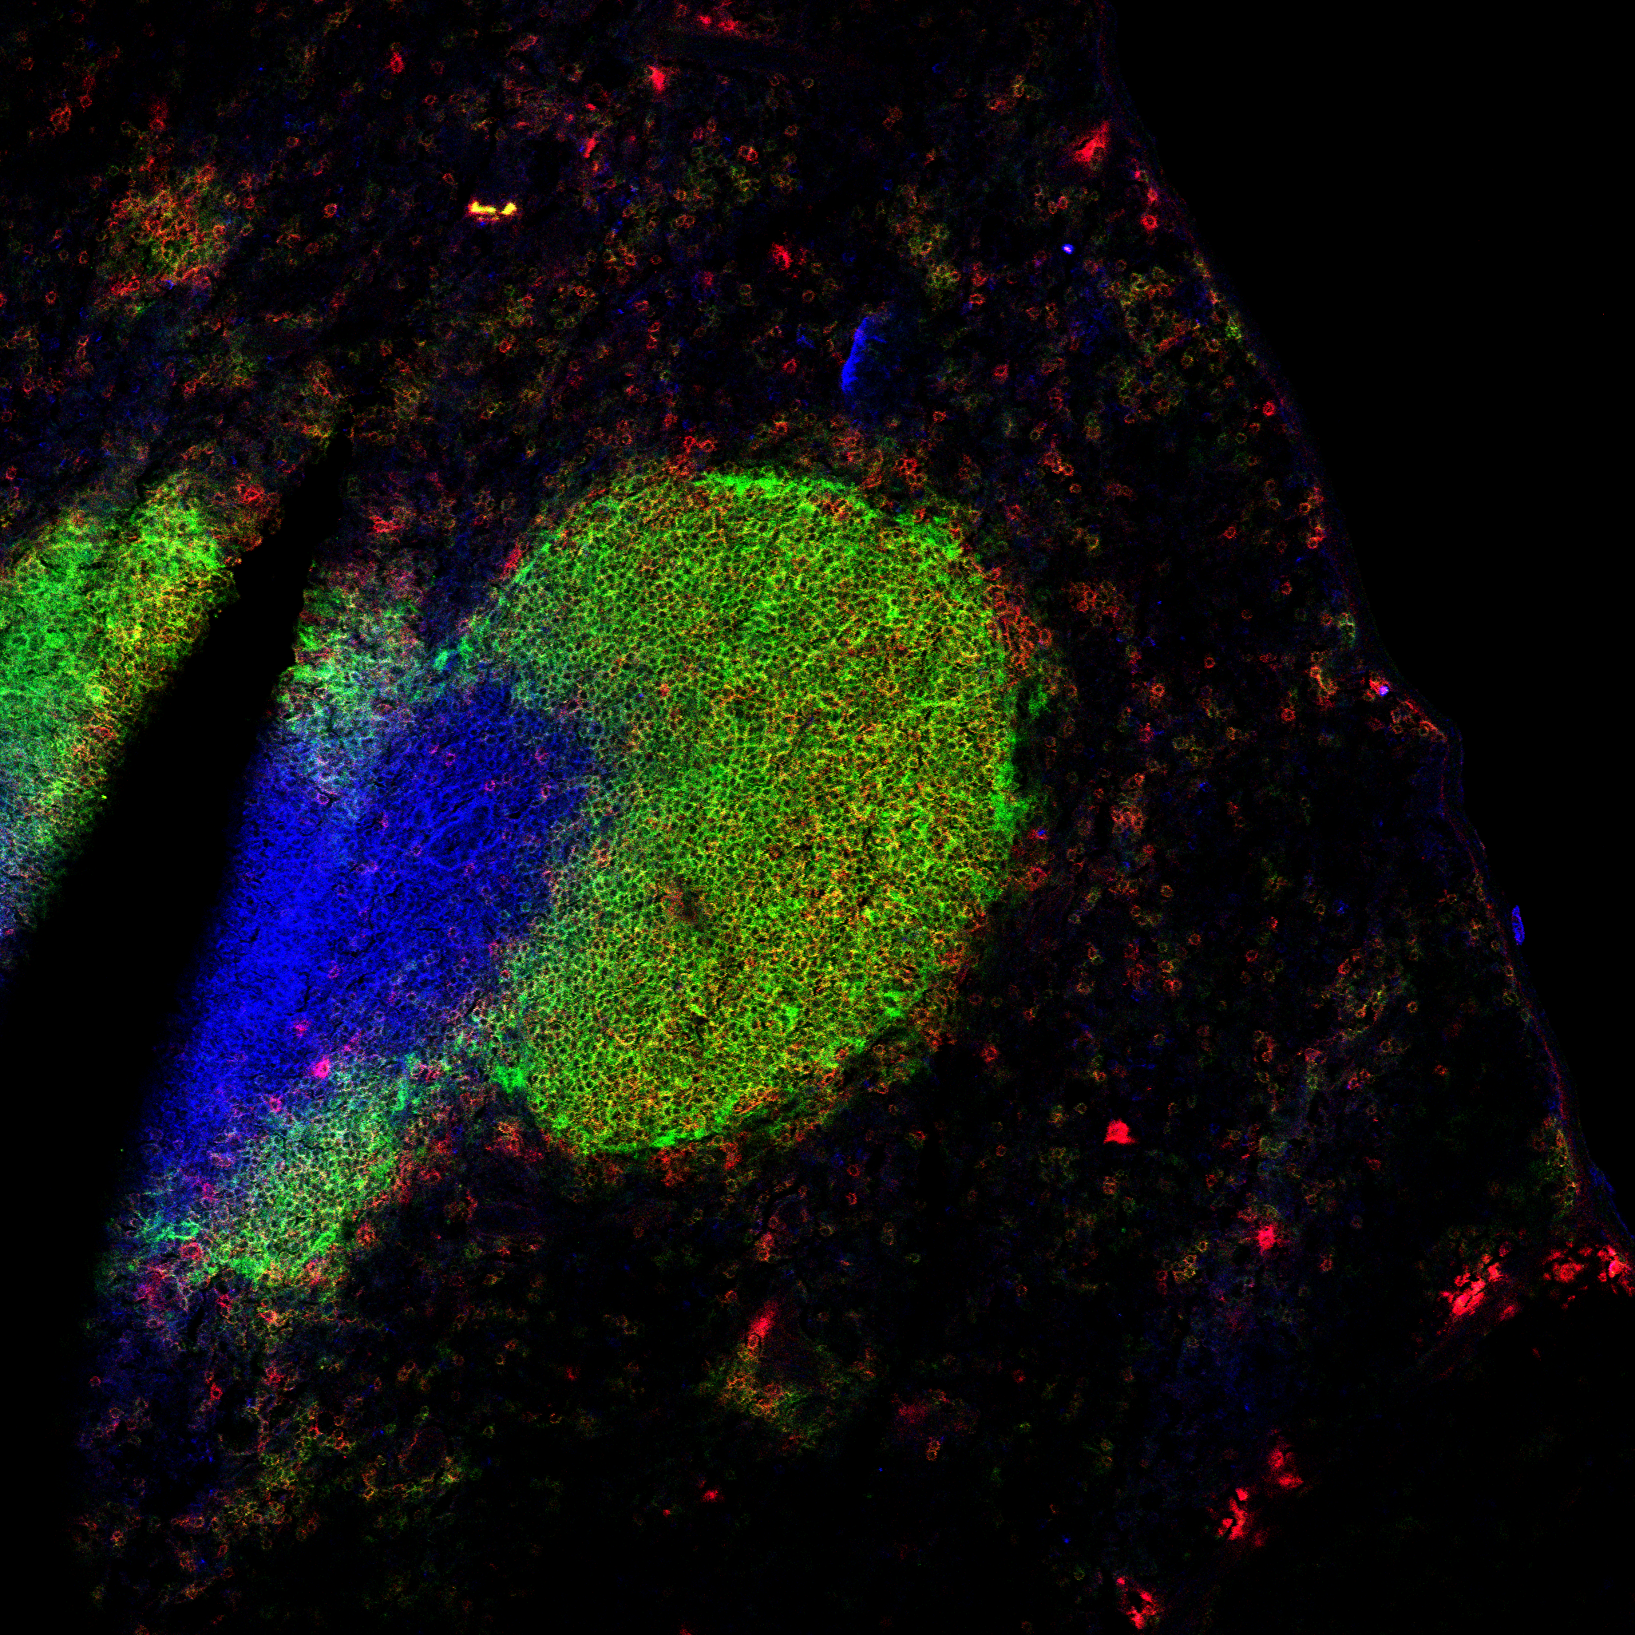
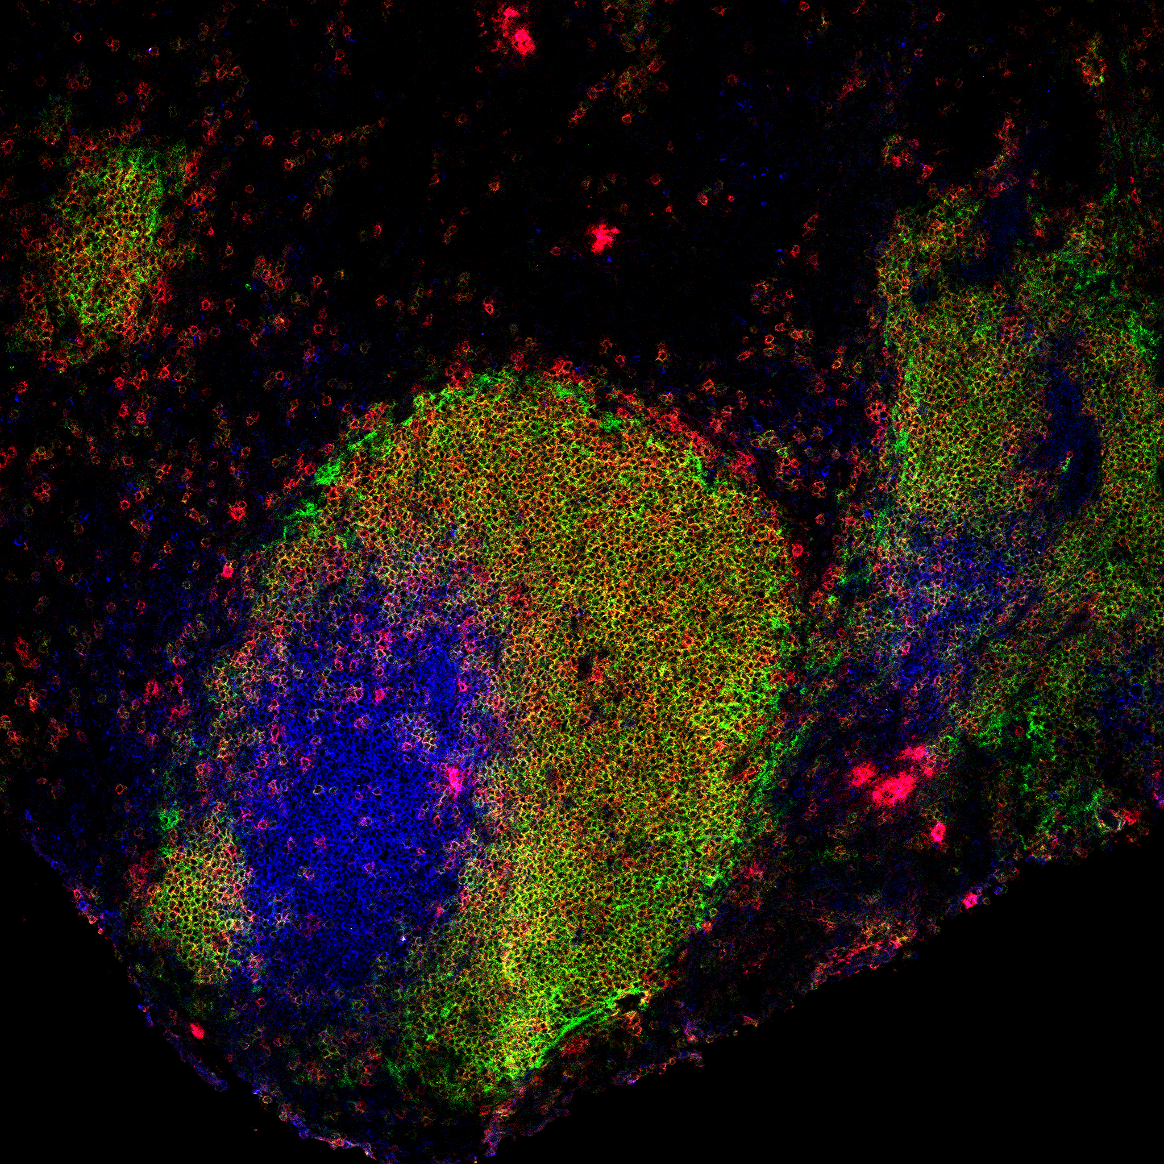
A wildtype-like Marginal Zone is regenerated after two weeks
IgD
MOMA-1
IgM
Thy1.2
WT
N2IC//ERT2, day0
MZBs
FOBs
T cells
N2IC//ERT2, day7
N2IC//ERT2, day14

